Slide 1
Database-First Approach Maintenance
Lecturer: Ngo Huy Bien
Software Engineering Department
Faculty of Information Technology
VNUHCM - University of Science
Ho Chi Minh City, Vietnam
nhbien@fit.hcmus.edu.vn

Slide 2

Objectives

Slide 3

Contents

Slide 4

References

Slide 5
Maintenance Steps
Create tables.
Update model from database.
Update code (Run Custom Tool).
Create wrapper for data access object (in data access layer).
Create interface for service (server side).
Create interface for service client (client side).

Slide 6
1. Create Tables
CREATE TABLE [dbo].[LocationGroupType](
[ID] [int] IDENTITY(1,1) NOT NULL,
[Name] [varchar](50) NOT NULL,
[IsActive] [bit] NOT NULL,
[DisplayOrder] [int] NULL,
[CreateUser] [varchar](50) NOT NULL,
[CreateDate] [datetime] NOT NULL,
[ModifyUser] [varchar](50) NULL,
[ModifyDate] [datetime] NULL,
CONSTRAINT [LocationGroupType_PK] PRIMARY KEY CLUSTERED
(
[ID] ASC
)WITH (PAD_INDEX = OFF, STATISTICS_NORECOMPUTE = OFF, IGNORE_DUP_KEY = OFF, ALLOW_ROW_LOCKS = ON, ALLOW_PAGE_LOCKS = ON) ON [PRIMARY]
) ON [PRIMARY]
GO
ALTER TABLE [dbo].[LocationGroup] WITH CHECK ADD CONSTRAINT [Dau_LocationGroup_FK1] FOREIGN KEY([DauID])
REFERENCES [dbo].[Dau] ([ID])
GO

Slide 7
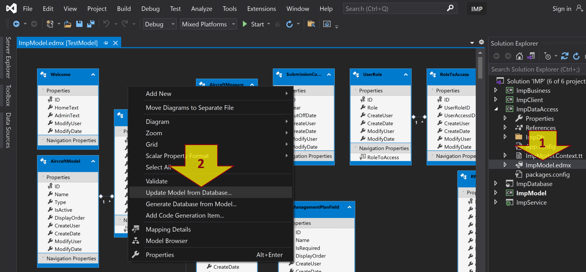
2. Update Model from Database (I)

Slide 8
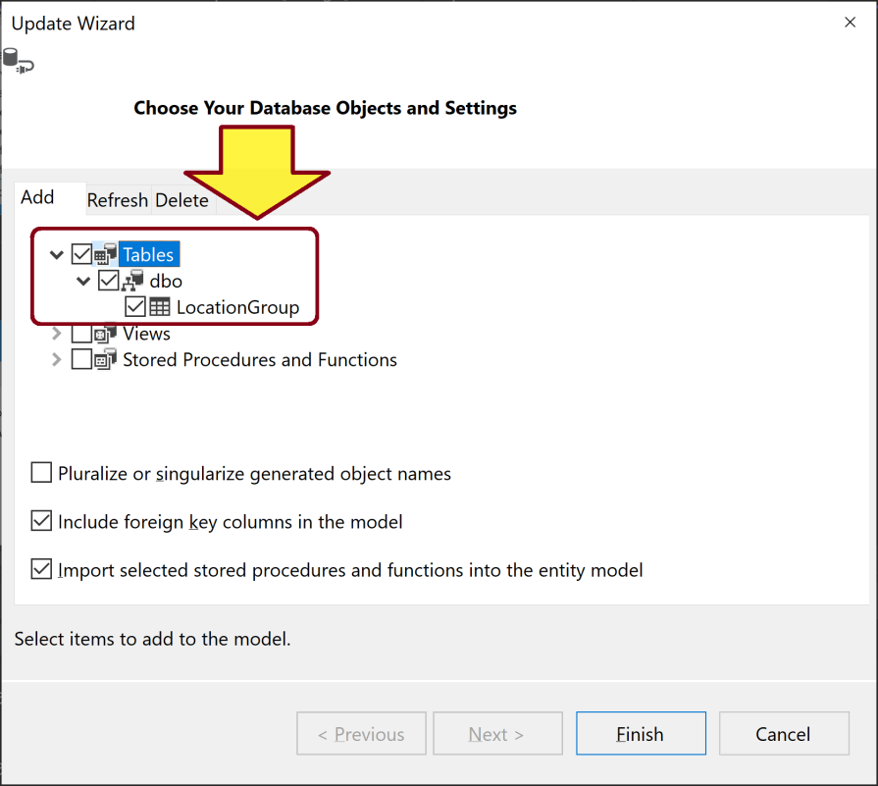
2. Update Model from Database (II)
Delete a table from the model and repeat updating the model if you get any issue with the table.

Slide 9
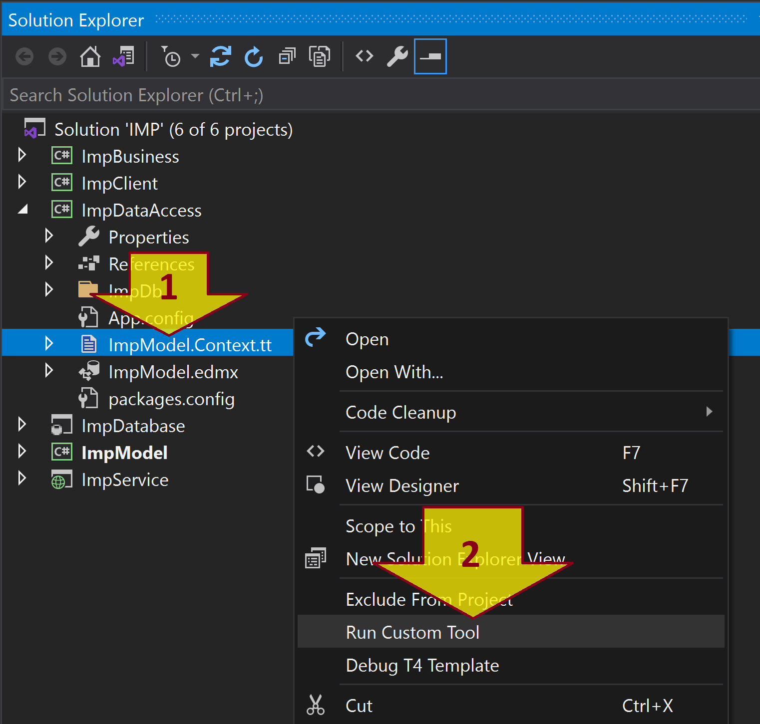
3. Update Code (Run Custom Tool)

Slide 10
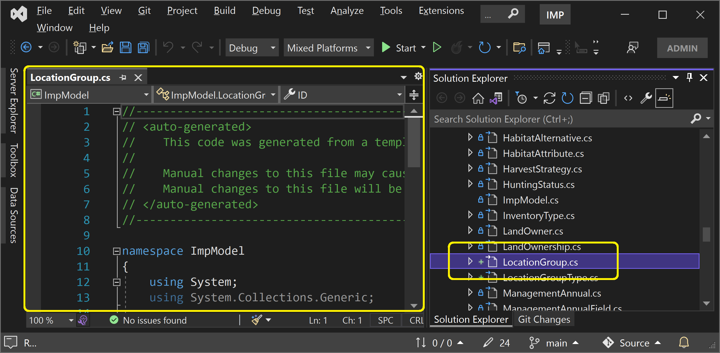
Verify Generated Code
Restart Visual Studio and repeat updating the code if the code is not generated.

Slide 11
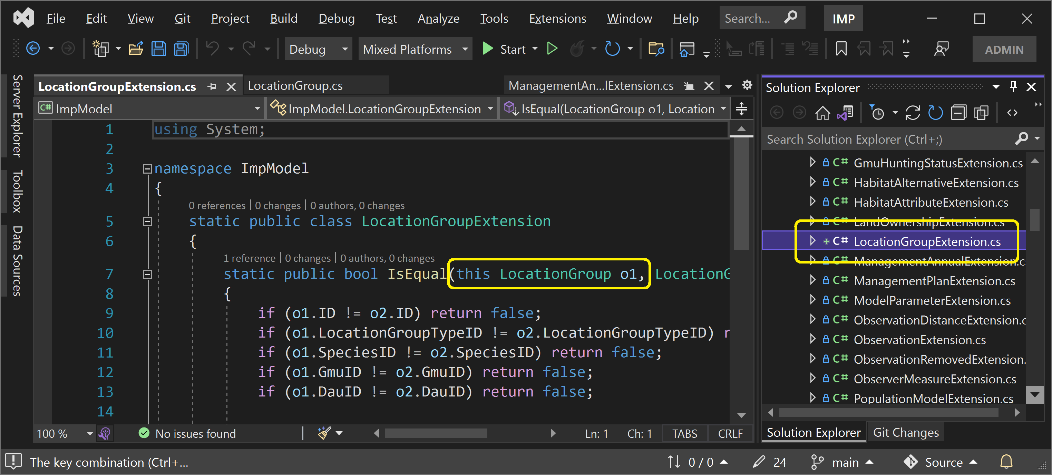
Extend the Generated Code
This action is optional.

Slide 12
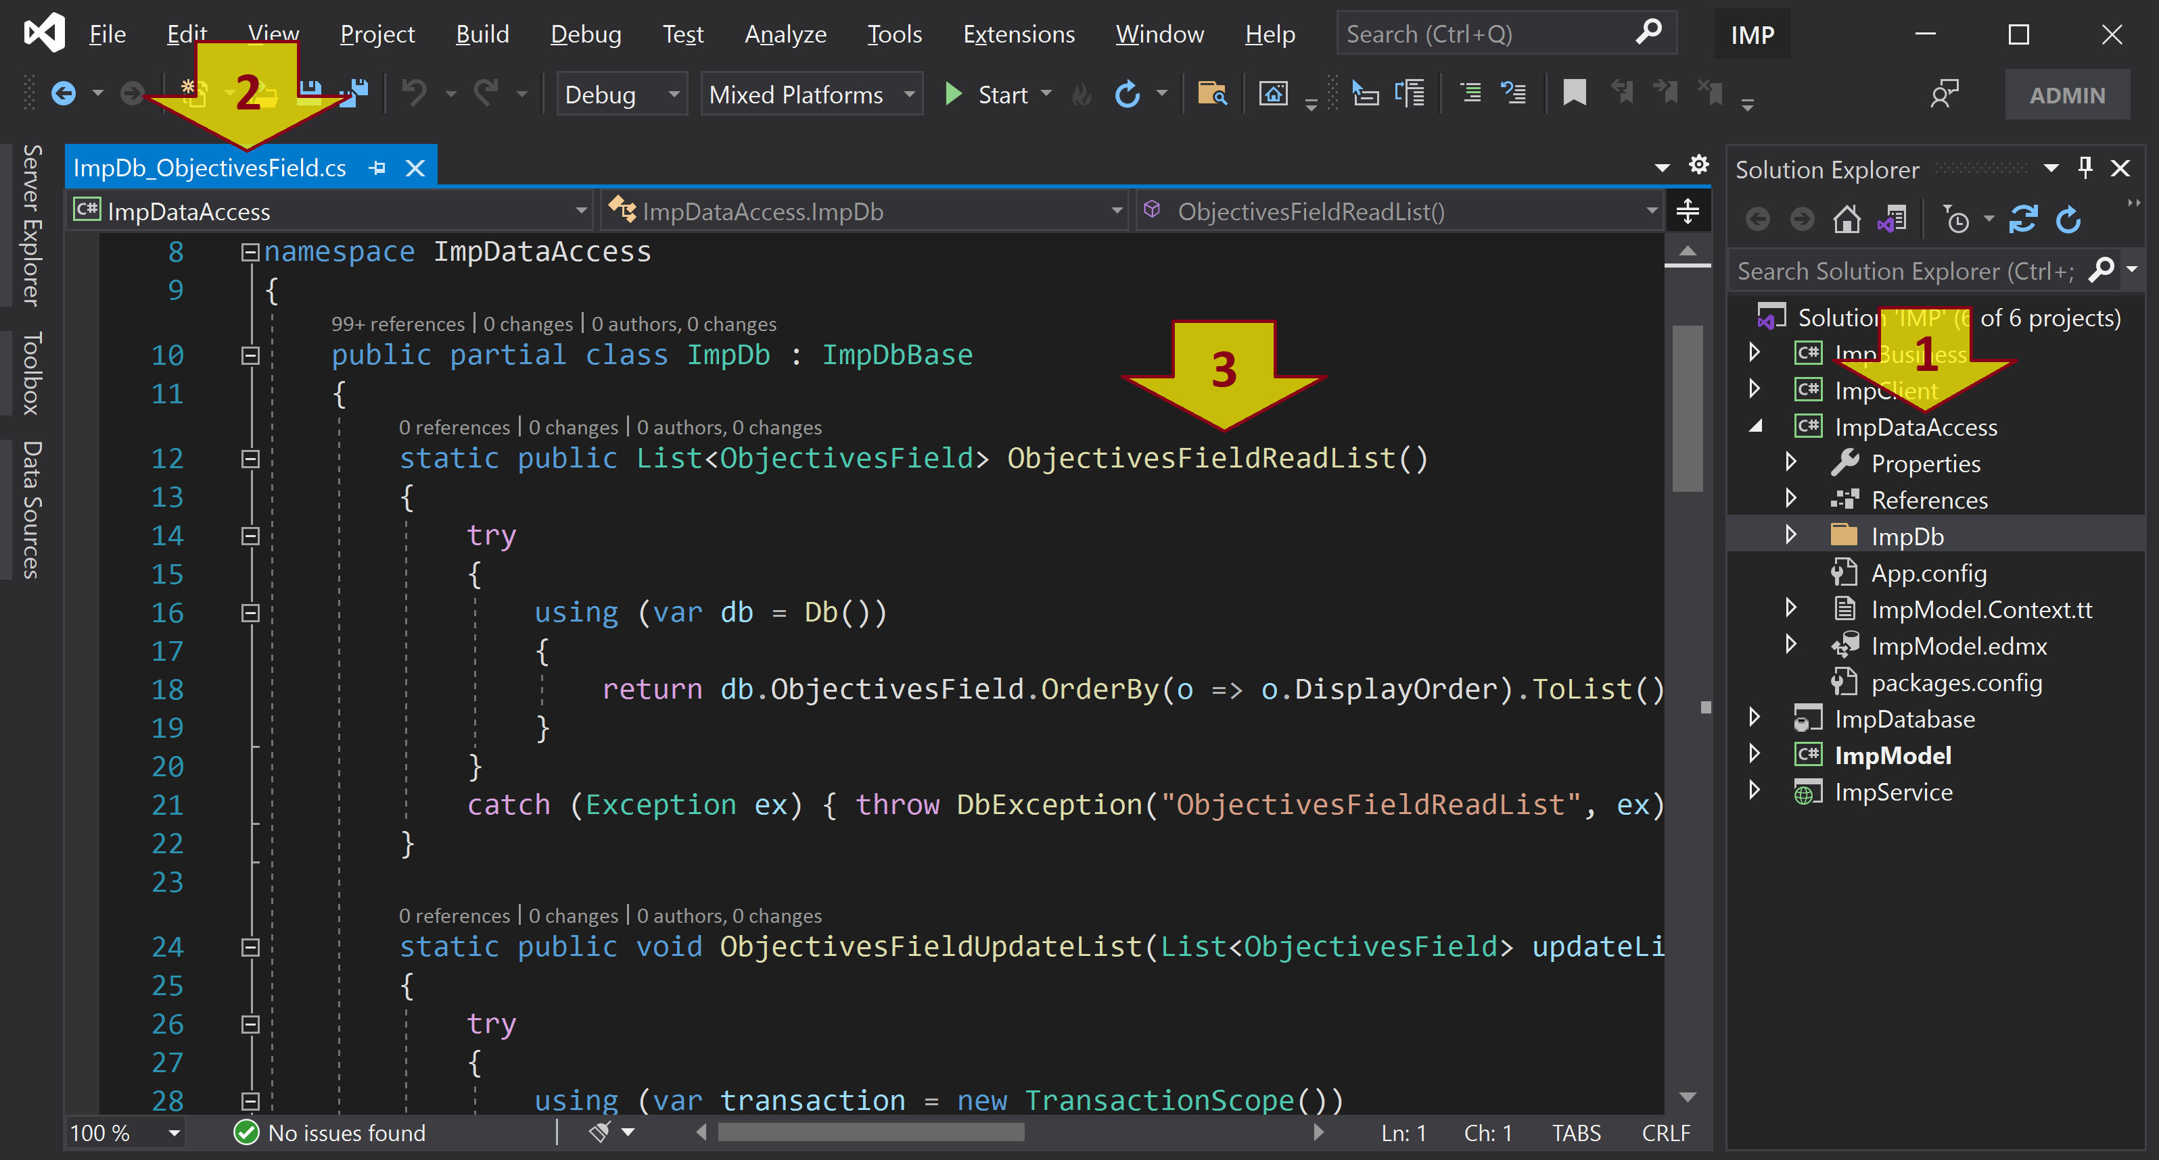
4. Create a Wrapper (Data Access Object/Repository)

Slide 13
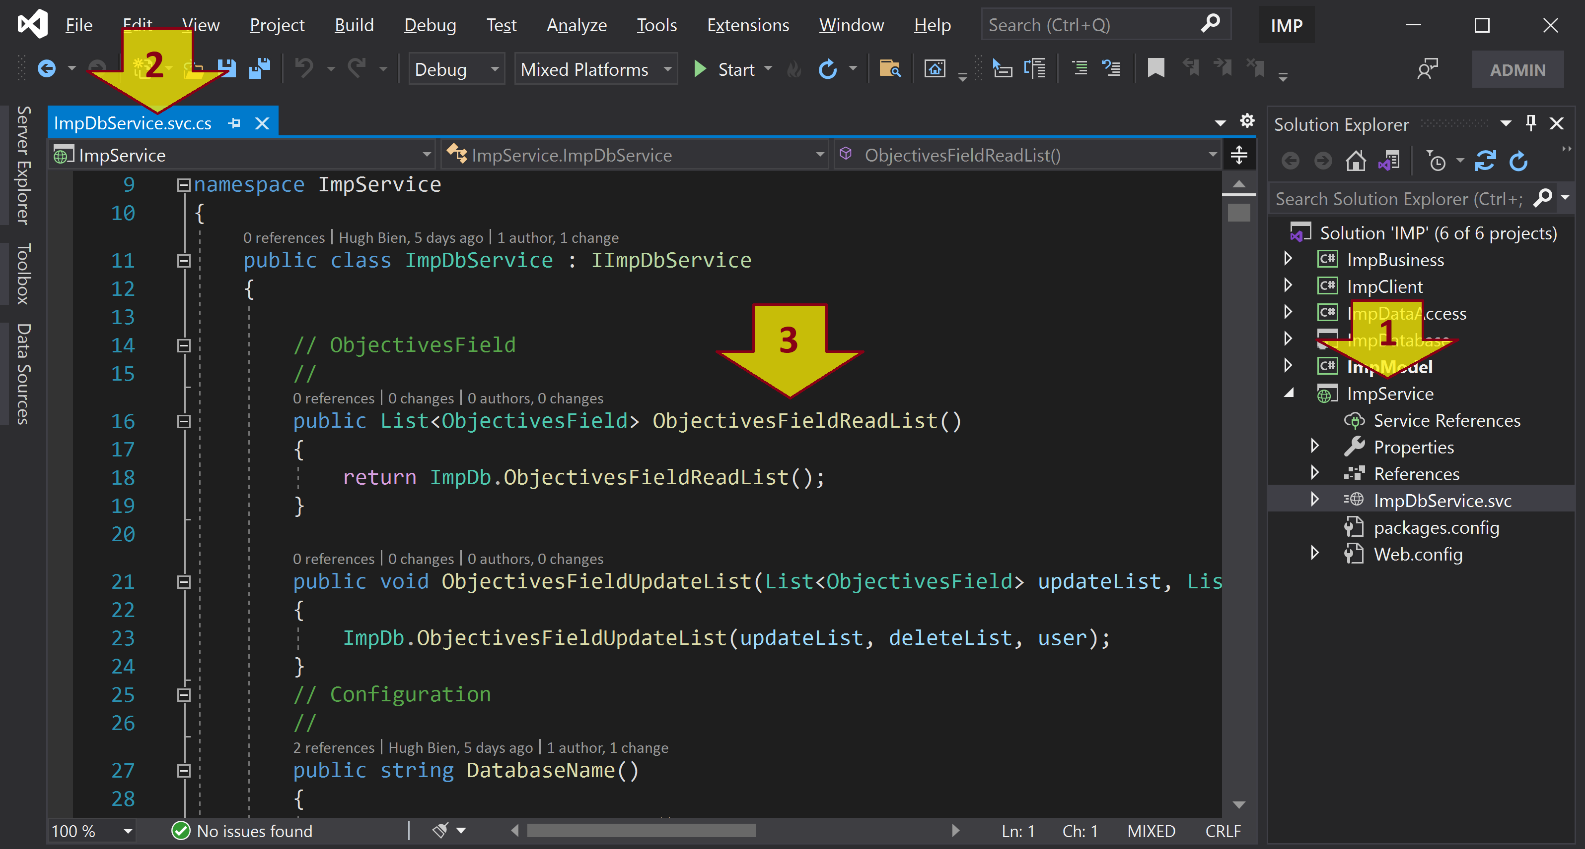
5. Create Service Interface (Server Side)

Slide 14
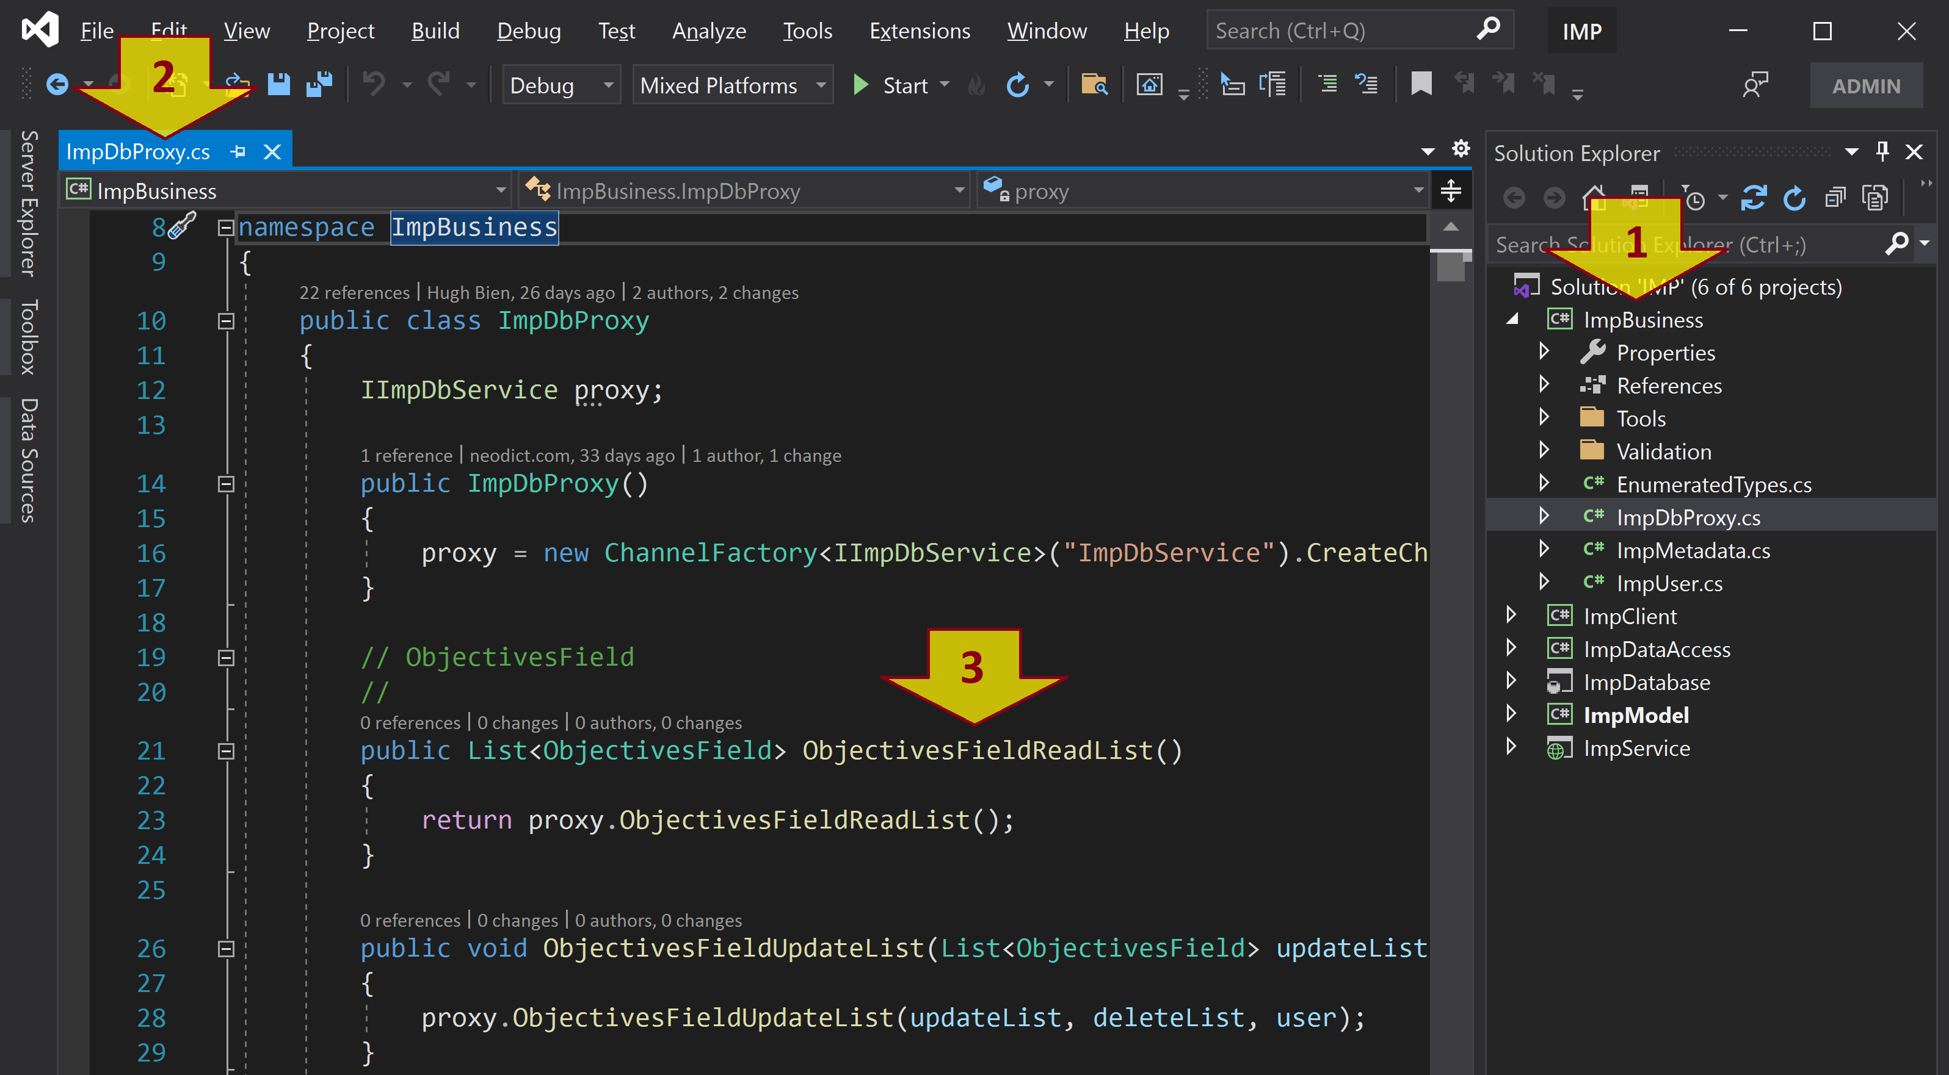
6. Create Service Client Interface (Client Side)

Slide 15

Further Reading

Slide 16

Thank You & See You Again

